Slide 1

AN
ANALYSIS
ON
GRAPHICAL NOVEL
KARI
- BY TEESYA, ANSHIKA AND PRATIKSHA

Slide 2


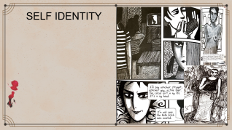
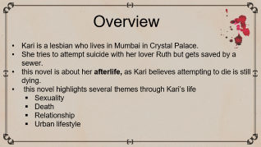
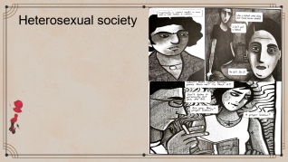
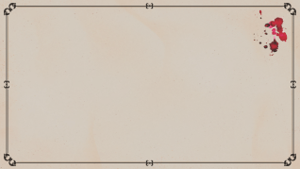

Slide 10
Overview
Kari is a lesbian who lives in Mumbai in Crystal Palace.
She tries to attempt suicide with her lover Ruth but gets saved by a sewer.
this novel is about her afterlife, as Kari believes attempting to die is still dying.
this novel highlights several themes through Kari’s life
Sexuality
Death
Relationship
Urban lifestyle

Slide 11
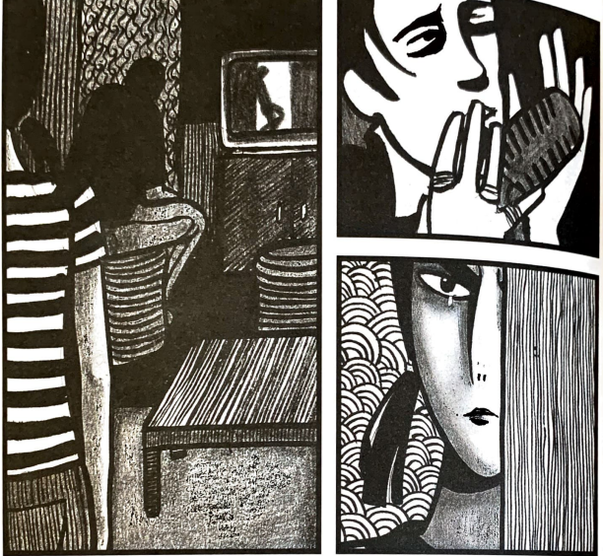
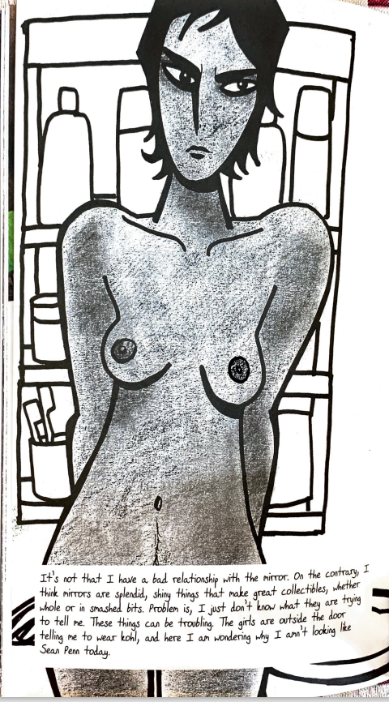
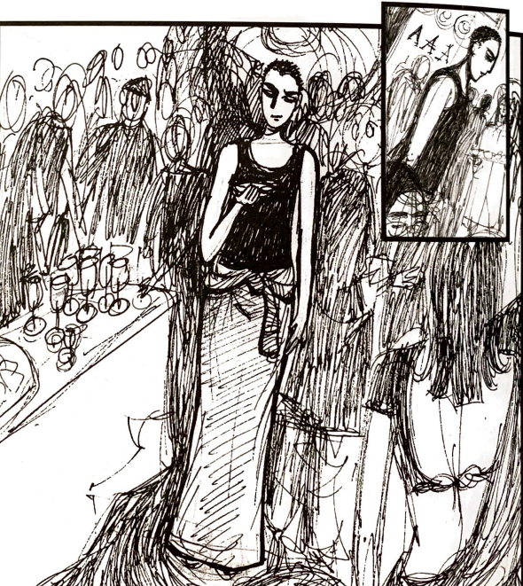
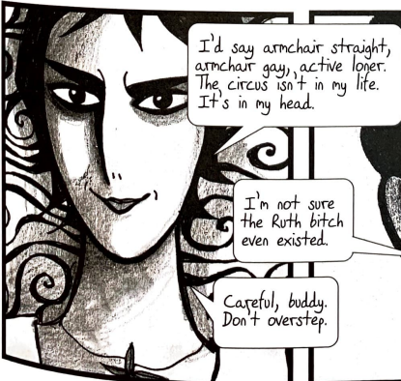
SELF IDENTITY

Slide 12
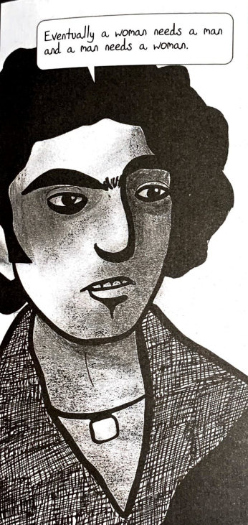
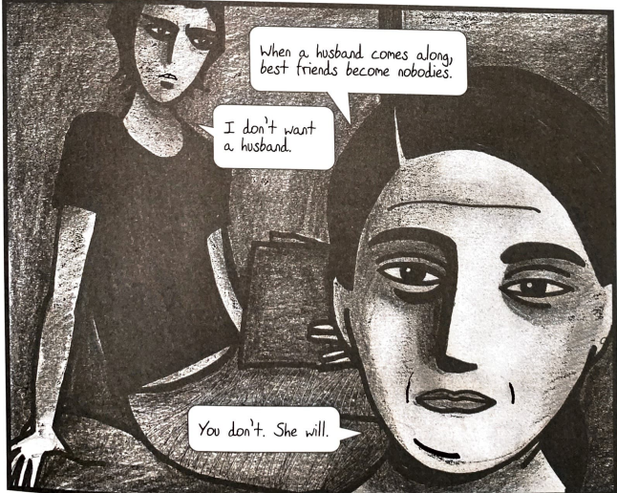
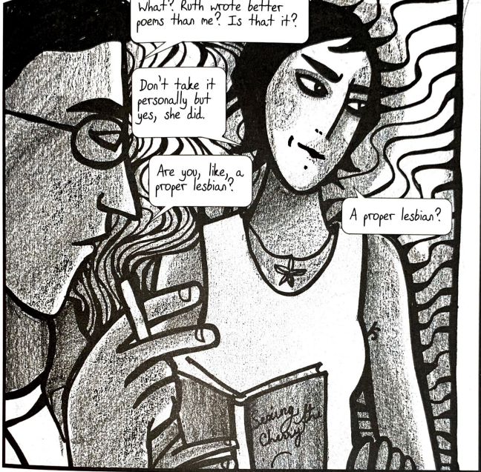
Heterosexual society

